Slide 1

AWS Agentic Stack and Claude with Sub-Agents
Notes:
Tool Integration: Search, Calculators, APIs, Short-Term and Long-Term Memory in Agents, Examples of Tool-Use and Memory-Enabled Agents

Slide 2

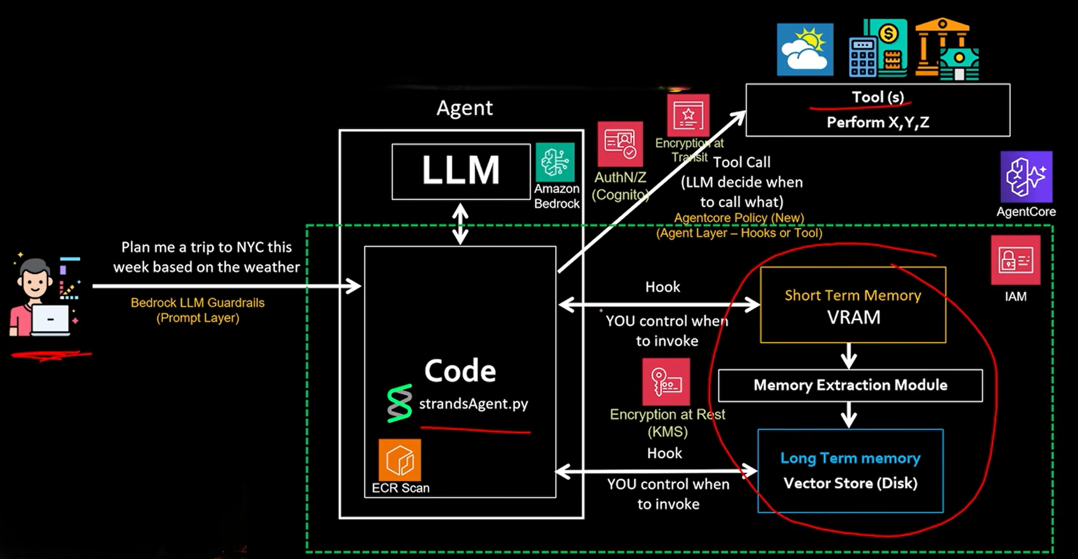
AWS – Value proposition of Agent

Slide 3
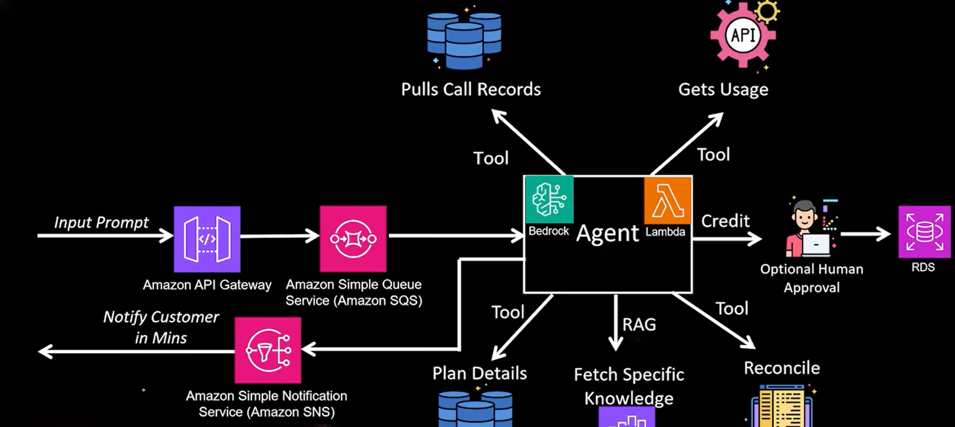
AWS – Agent on the Cloud
Customer calls about the unexpected charge in bill, rep logs in to separate systems, pull call records, usage, plan details, any additional feature added. Cross references talk to Specialists; credit issued to customer.

Slide 4
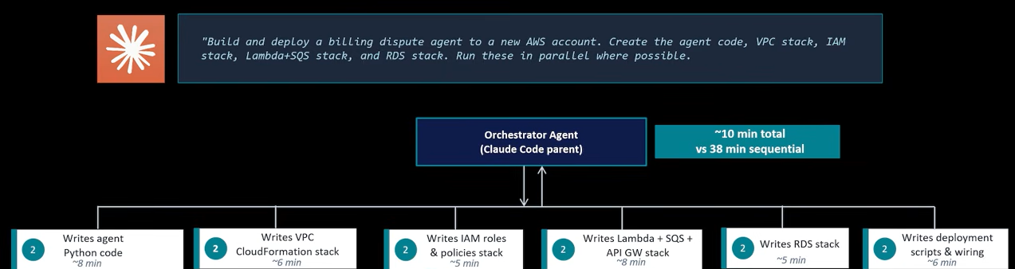
Claude Sub-Agents – Run In Parallel
A Sub-agent is a separate Claude instance spawned by an orchestrator to do one focused job
Each sub-agent gets only the context it needs – nothing more
Sub-agents run in parallel – they have no awareness of each other
The orchestrator controls what they receive, sequences dependencies, and merges results
Sub agents don’t talk to each other
Best for: parallel and independent tasks
Speed is the payoff –N tasks in the time it take do 1

Slide 5
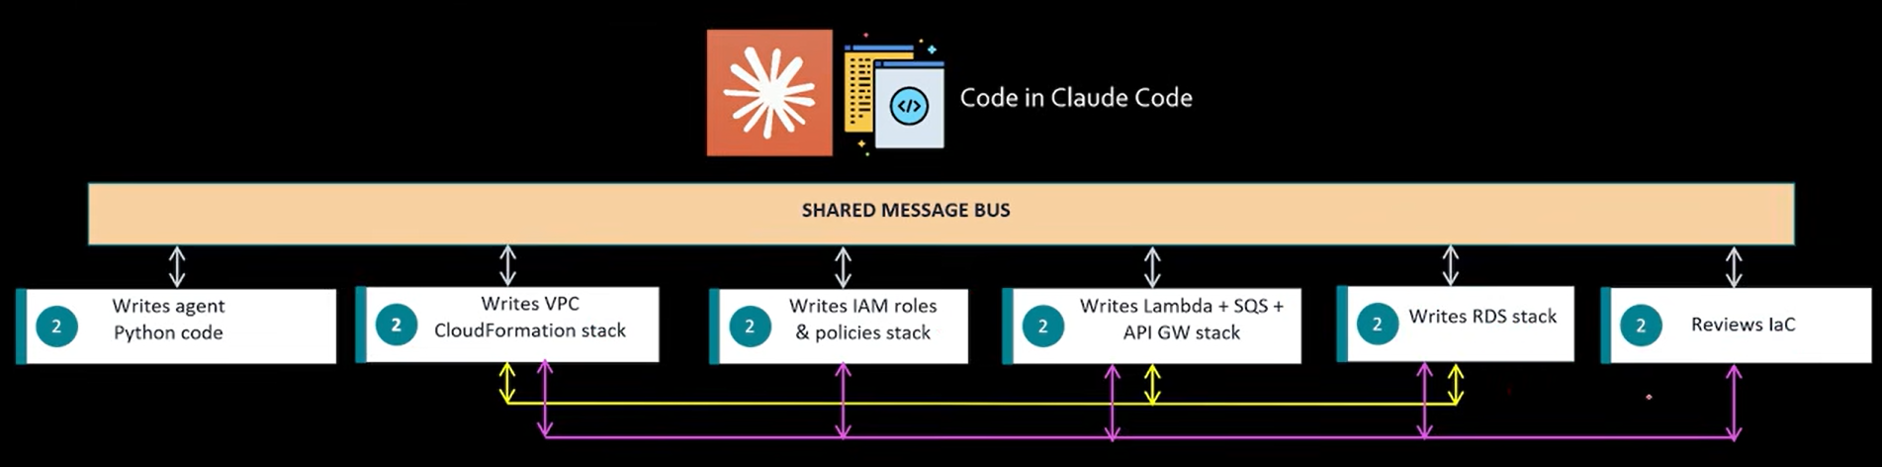
Claude Agent Teams
Higher quality output because of feedback loop
Mimics human teams
Not re-do

Slide 6
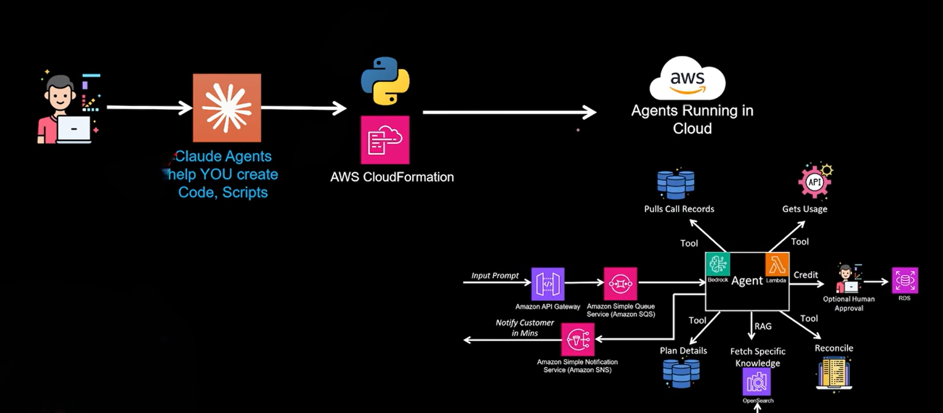
End 2 End

